Slide 1

Start your datacentre transformation journey with Azure Migrate
Sarah Lean
Cloud Advocate | Microsoft
@Techielass
Notes:
Test clicker

Slide 2
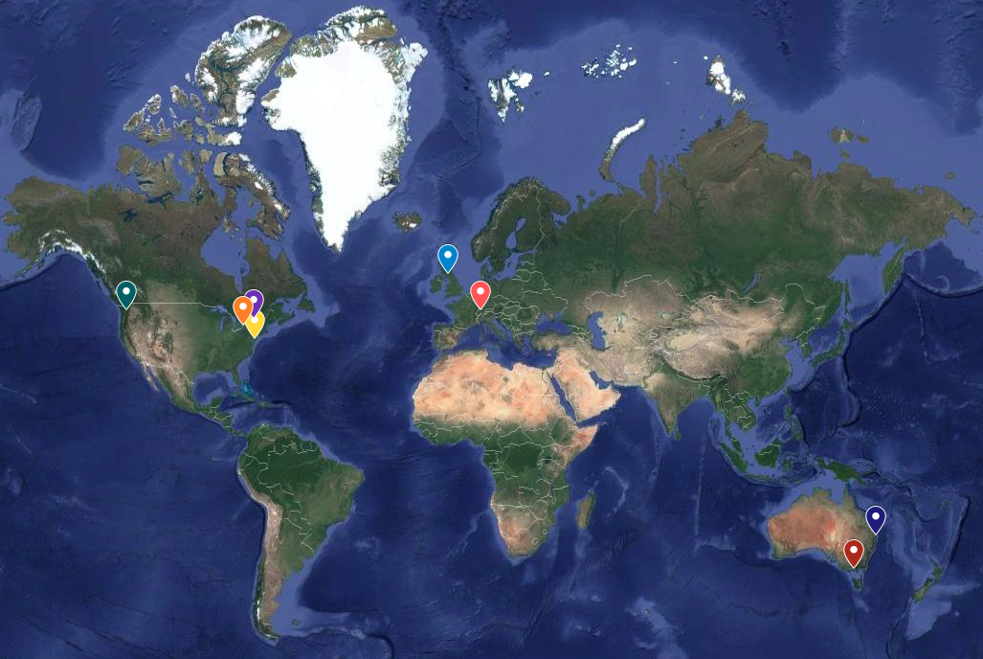
@Techielass
Notes:
I am part of a global team

Slide 3

Scotland is the home of…
@Techielass
Notes:
And I’m from Scotland. Scotland is the home of the Highland Coo

Slide 4


Scotland is the home of…
@Techielass
Notes:
And Scotch Whisky. My favourite is the Balvenie.

Slide 5
Scotland is the home of…
Keep the heid!
- Stay calm, don’t get upset
Haud yer wheesht!
- Be quiet
Am pure done in
- I’m tired
Bonnie
- Beautiful
Aye
- Yes
Naw
- No
Wee
- Small
Tin
- Physical Server
@Techielass
Notes:
Here are also some crazy words and phrases

Slide 6
Software and hardware refresh
Security threats
Urgent capacity needs
Compliance
Quickly integrate acquisitions
Application innovation
Migration drivers
Software end of support
Datacenter contracts expiry
@Techielass
Notes:
There are a number of reasons that are driving people to look at Azure

Slide 7
Extended security updates for 2008 and 2008 R2 – free in Azure
IaaS: Move to Azure VMs, get 3 more years of extended security updates at no additional charge
PaaS: Move SQL Server to Azure SQL Database Managed Instance (version free, fully managed, no patching needed)
Use Azure Hybrid Benefit to maximize on-premises investments
Migrate to Azure
SQL Server 2008 and 2008 R2
Extended support
ends July 9, 2019
Windows Server 2008 and 2008 R2
Extended support
ends January 14, 2020
Upgrade to current Windows Server/ SQL Server versions
OR
Buy 3 more years of extended security updates on 2008/2008 R2
2018
2019
2020
Stay on-premises

Slide 8
Migration stages
Discovery & Assessment
Migrate
Optimize
Secure and manage
Foundational best practices: People | Process & Planning | Technology
@Techielass
Notes:
Summary:
Key phases of the Azure migration experience – workload assessment and discovery, workload migration, ongoing optimization (Cost Management, AHB, RI) and security/management (built in services – backup, monitoring, blueprints etc.)
Key investments – tools, prescriptive guidance, and handholding
3) Foundational best practices which are critical enablers to help you scale up your efforts – skilling up people, investing in the right processes – e.g., biz case/exec support, mix of migration strategies, tracking migration), and tech (governance, networking, identity, security and management tools)

Slide 9
Azure Migrate

Slide 10
Azure Migrate timeline
Sept 2017 – Azure Migrate announced
August 2018 – New price modelling functionality launched
July 2019 – Version 2 launched
Feb 2018 – Goes GA!
Jan 2019 - new region support launched
Nov 2019 – Agentless functionality previewed
@Techielass
Notes:
Azure Migrate was first launched in 2017 and went generally available in early 2018. Since then it’s went under a number of changing adding great functionality along the way.

Slide 11
Hub for Datacenter Migration
Key migration scenarios
Azure Migrate
Centralized migration repository with end-to-end tracking
Integrated discovery, assessment, and migration capabilities
Powered by Microsoft and extensible with ISV partner tools
@Techielass
Notes:
It’s now the hub of data centre discover, assessment and migrations.

Slide 12

Discovery
@Techielass

Slide 13
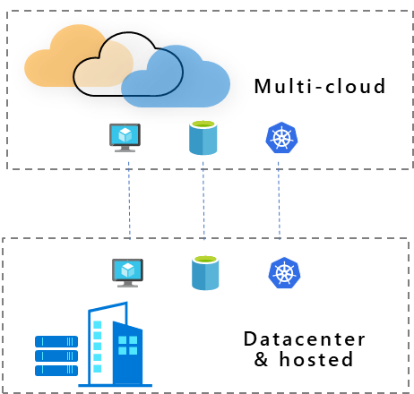


Scenarios
Windows and Linux
VMware, Hyper-V, Physical, Other Clouds
^{NEW} Virtual Desktop
SQL and other databases
^{NEW} Web apps
Data
@Techielass

Slide 14
Appliance-based for virtual machines
No pre-setting or pre-configuring a machine
No installation of pre-requisite software
Can be treated like any other server in your estate
@Techielass

Slide 15
Installer-based for physical servers
There are pre-reqs to meet
Install Migrate appliance via download/script
Server doesn’t have to be physical
@Techielass
Notes:
https://docs.microsoft.com/azure/migrate/tutorial-prepare-physical?WT.mc_id=cloudbrew-event-salean#prepare-for-physical-server-assessment

Slide 16
Demo
FUN TIME
@Techielass

Slide 17

How are your servers connected?
#
@Techielass

Slide 18
Dependency Mapping
Agent Based
Agentless - https://aka.ms/appmapping
@Techielass

Slide 19
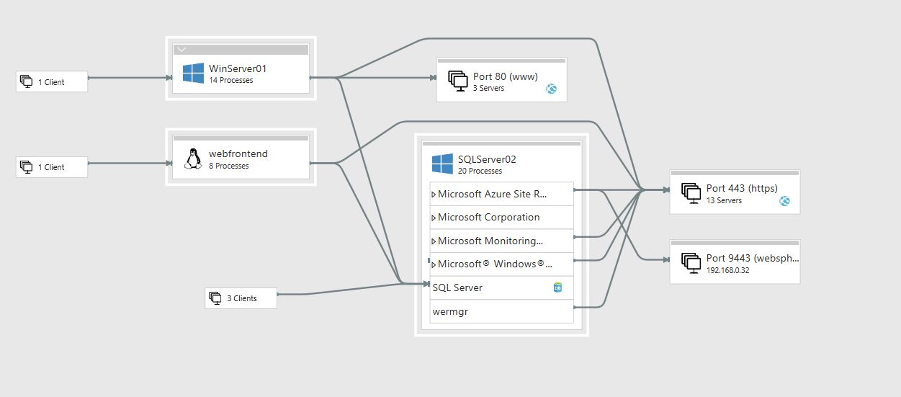
@Techielass
Notes:
Presents a view of your servers as you think of them – as interconnected systems
Discovers and maps server and process dependencies in real-time

Slide 20
Migration Assessment
Three stages
Suitability Analysis
Sizing
Monthly Cost estimation
@Techielass

Slide 21
Demo
FUN TIME
@Techielass

Slide 22

Migrate
@Techielass

Slide 23
Azure migration & modernization scenarios
App
Migration & Modernization
Cloud-native
SaaS
On-premises
Data
Rehost
Refactor
Rearchitect
Rebuild/New
Replace
Infrastructure
Virtual Machines
Containers
App, Data, & AI Services
Security | Management
@Techielass
Notes:
These are the Azure migration scenarios and associated technologies. These scenarios are based off of an industry standard framework.
Rehost: Redeploy as-is to cloud; used for quick ROI, freeing up DC space, least effort. IaaS is the key tech here.
Refactor: Minimally alter to take better advantage of cloud; used for code portability and quick updates. Containers and PaaS are the key tech here.
Rearchitect: Materially alter/decompose application to services; to enhance app scale and agility. PaaS, Serverless and Microservices are key tech here.
Rebuild: New code written with cloud native approach; to accelerate innovation and build apps faster. PaaS, Serverless and Microservices are key tech here.

Slide 24
There is no right or wrong answer.
@Techielass

Slide 25



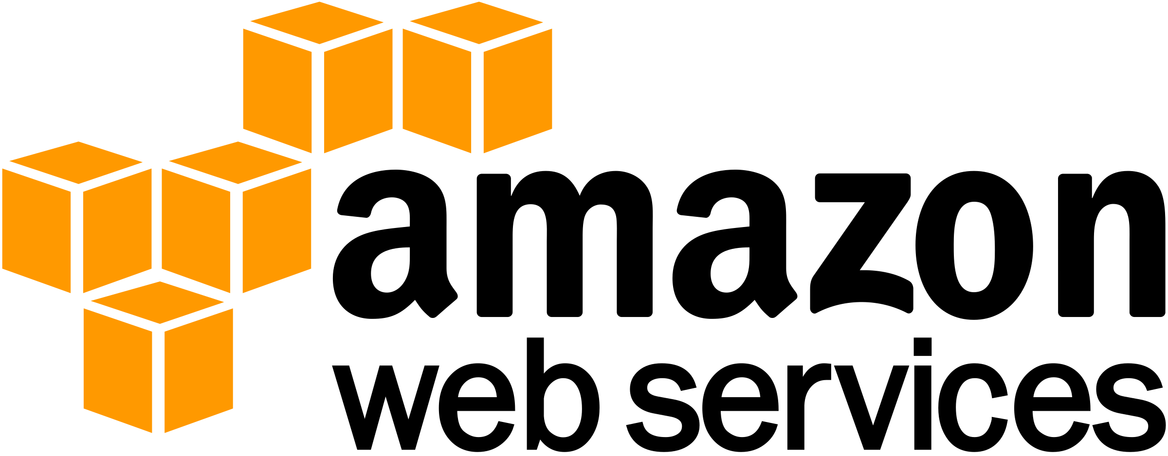

Migration
Any to Azure
VMware, Hyper-V, physical servers, AWS, GCP
^{NEW} Agentless VMware migration
Now generally available
Test before migrate
No-impact production testing
Zero data loss
And minimal downtime during migration
@Techielass

Slide 26

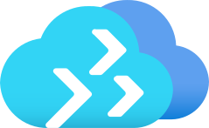
Azure Site Recovery or Azure Migrate
@Techielass

Slide 27

Optimize
@Techielass

Slide 28

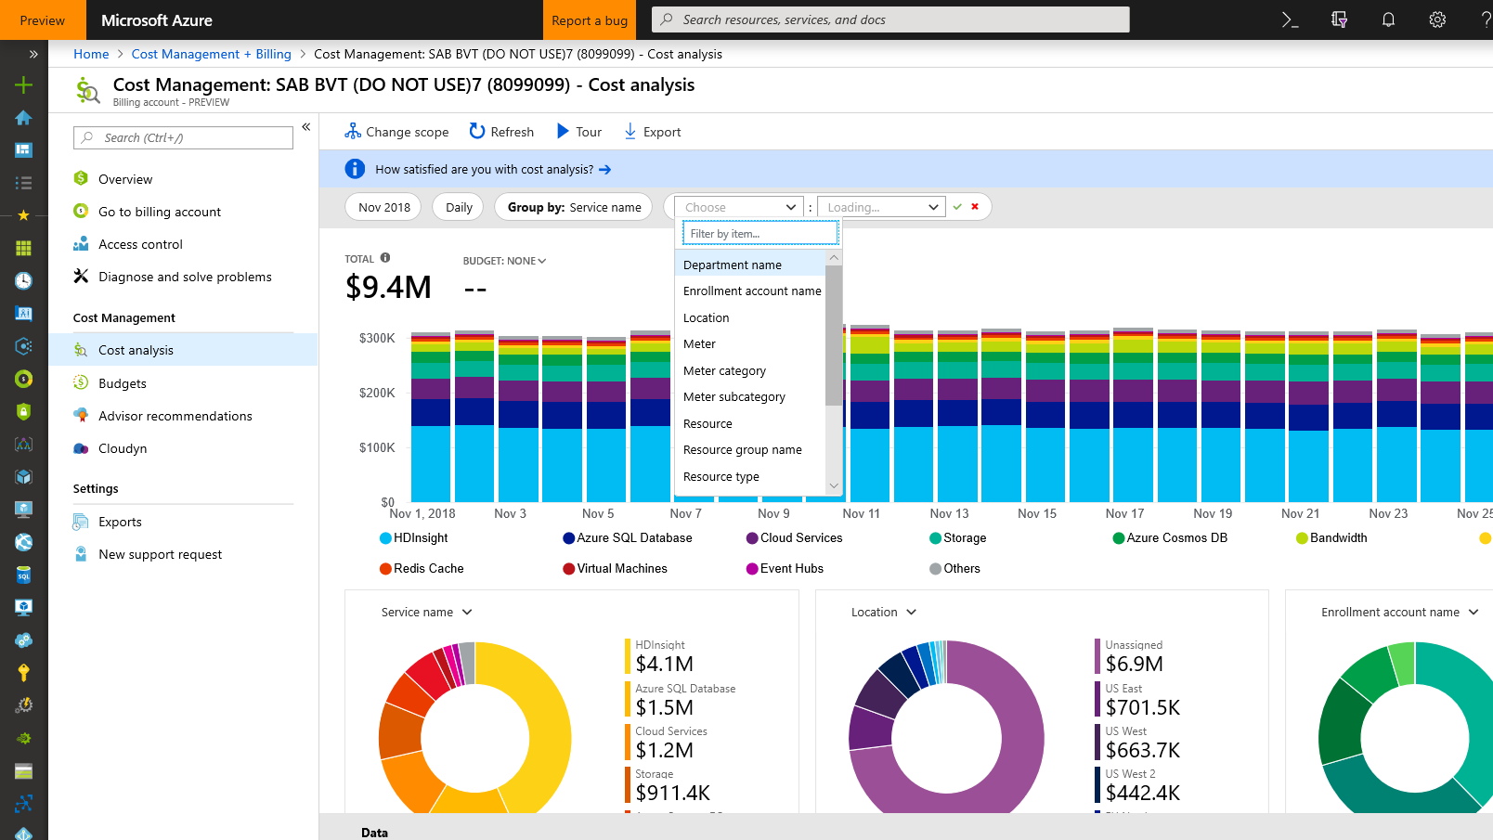
Monitor cloud spend
Track usage and cost trends
Detect spending anomalies and usage inefficiencies
Forecast future spend using your historical data (Coming soon)
Visualize data in consolidated or custom dashboards
@Techielass
Notes:
Monitor cloud spend
With Azure Cost Management, you can gain access to rich operational and financial insights:
Monitor resource usage and costs on a daily or monthly basis and track the trends across all your clouds in any way you want (by resource types, by business units, by projects, etc.)
Detect usage and spending anomalies, which could be a good thing (for example, a spike in customer demand after a holiday) or an anomaly that requires immediate investigation. You can also detect usage inefficiencies and take actions to address them.
And forecast future spend more accurately based on historical data
All these insights are visualized in intuitive dashboards. One key advantage of Azure Cost Management is that you can see your cloud usage and spend from different clouds in one single, unified view. You can also customize the dashboards based on roles.
The screenshot you are looking at shows a management dashboard that has everything managers need to know about their cloud usage and spend.
Next, we can easily see how actual cloud expenses are lining up to your budget, in this case, a month by month view.
You can also dive deeper to look at daily costs and detect any spikes on a specific point in time—really helpful in locating anomalies. In this case, you have a huge cost spike on August 15. You better look into what caused it.

Slide 29
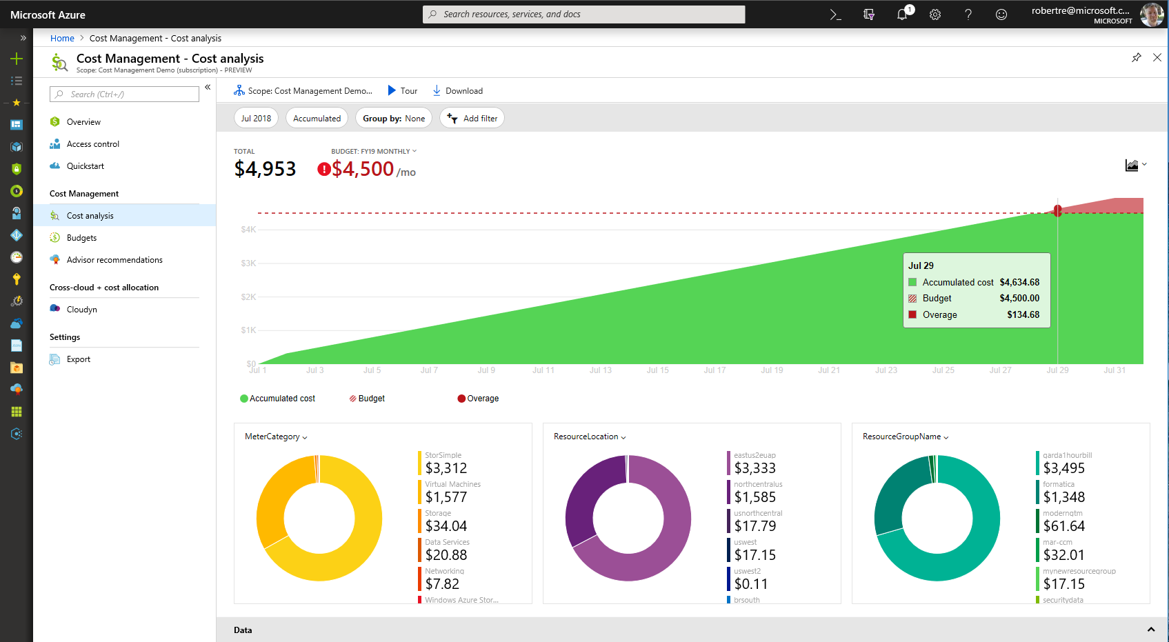
Drive organizational accountability
Ability to create budgets and alerts
Let teams access data and insights with Role-Based Access Control
Automatically alert stakeholders of spending anomalies and overspending risks
@Techielass
Notes:
Allocate usage and costs to business units and projects (coming soon – Move to talking track)
Produce and chargeback/showback reports (coming soon) Move to talk track
Drive organizational accountability (this slide discusses benefits about budgets)
The next ability is driving organizational accountability.
Accountability is a difficult thing to track or drive in any organization, but Azure Cost Management helps you drive accountability by enabling visibility at the most granular level and enforcing compliance with governance policies, alerts, and notifications.
Allocate usage and costs to business units and projects using resource tags.
Produce chargeback and showback reports.
Empower teams to better manage their cloud spend by giving individuals access to data and insights with Role-Based Access Control.
Set custom thresholds of spending vs. budget and alert stakeholders through automated notifications when they are at risk of overspending. You can also automatically alert stakeholders of usage and spending anomalies.
The screenshot shows cost allocation by workload and usage types so you can get visibility into who is using cloud resources for what purposes and the cost for each area. In this case, production is using the majority of cloud resources compared to R&D, Integration and DevOps, which is expected
Next is a chargeback report you can produce on a regular basis and email to stakeholders.
And finally, you can’t have your people keep checking on everything manually all the time, so there is an alert and notification system that allows you to set custom thresholds and policies and automatically send alerts & notifications to key stakeholders.

Slide 30
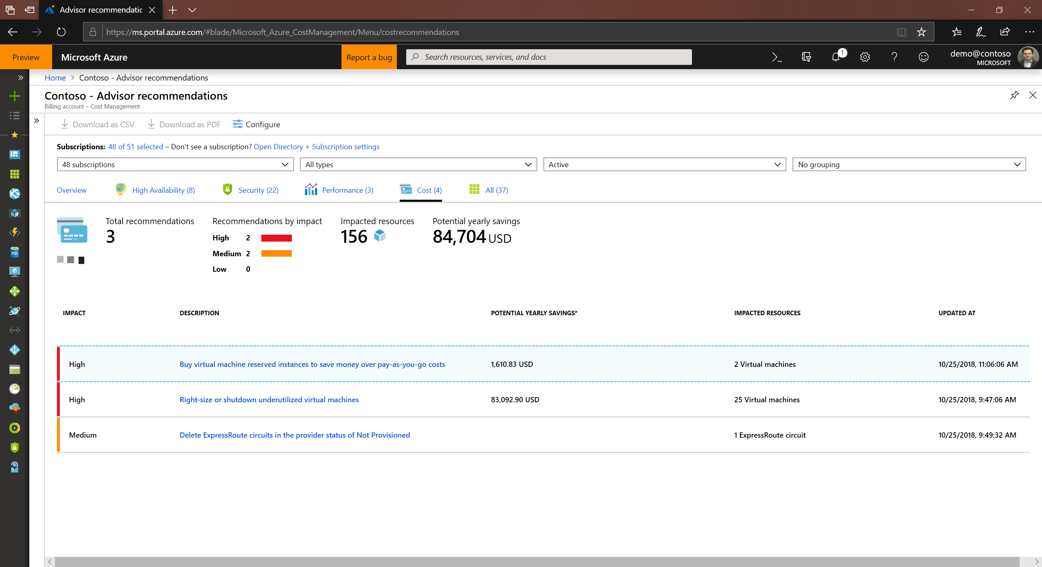
Optimize cloud efficiency
Increase resource utilization with virtual machine right-sizing
Eliminate idle resources
Reserved Instances recommendations
Take advantage of Azure Hybrid Benefits
@Techielass
Notes:
Optimize cloud efficiency
Finally, there’s optimizing cloud efficiency to improve ROI. There are three main ways Azure Cost Management lets you optimize cloud efficiency:
Increase resource utilization with virtual machine right-sizing. The tool tracks VM utilization, makes actionable recommendations on right-sizing and provides estimated cost savings. Right-sizing recommendations are made by types: general purpose, compute optimized, memory optimized or graphic optimized.
Azure Cost Management also detects idle resources such as unattached disks and unused memory, and makes recommendations to turn those off so you can eliminate waste.
Azure Cost Management offers another cool capability – helping you optimize virtual machine reserved instance purchases so you can maximize the cost savings. The service currently support AWS reserved instance management and will support optimizing Azure virtual machine reserved instances once it becomes available.
The screenshot here shows VM efficiency - you can see a view across all IaaS instances and their CPU utilization.
Next screenshot: sizing recommendations – you can see a list of sizing recommendations for your VM instances including what size is recommended based on the usage and the potential cost savings. You can double click on each line item to get more details.
Next screenshot: You see a list of unattached disks detected by the tool so you can turn them off and reduce waste.
Next screenshot: reserved instance purchase impact. Here you can see the cost of AWS workloads for a pay-as-you-go pricing shown in the blue bar and the cost if I pre-purchased a reservation with the green bar. I can save $5,734 of the cost by purchasing reserved instances up front.

Slide 31

Secure & Manage
@Techielass

Slide 32
Cloud security is a shared responsibility
Shared responsibility model for cloud security
Microsoft’s commitment
Joint responsibility
Secure foundation
Microsoft provides built-in controls
Physical assets
Virtual machines and networks
Datacenter operations
Apps and workloads
Cloud infrastructure
Data
@Techielass
Notes:
It’s also a joint responsibility between Microsoft and the customer
Securing and managing your Azure resources is a joint responsibility, shared between you and Microsoft.
Our (Microsoft’s) commitment is to securing and managing the cloud foundation through:
Security and management of physical assets:
Multiple layers of physical protection from the perimeter to buildings to computer rooms
State-of-the-art security controls such as video coverage, biometrical authentication, verified single-person entry
Provisioning and maintenance of all the hardware.
Datacenter operations security and management:
Security operations center, with 24x7x365 security operations.
Comprehensive and quick incident assessments.
Continuous monitoring by security experts.
Cloud infrastructure security and management:
Secure multi-tenancy
DDos defense system
Data segregation and encryption
And it’s a joint responsibility to secure and manage your cloud resources in an IaaS model.
Customers have the responsibility to keep their virtual machines, applications and workloads, and data secure and well-managed.
And Microsoft provides the tools natively to make it easy for you to secure and manage your cloud resources.
Now let me show you how you can take simple steps to keep your Azure resources secure and well-managed.

Slide 33



Azure Security Center
1
Strengthen security posture
Protect against threats
Cloud security posture management
For servers
For cloud native workloads
For databases and storage
Secure Score
Policies and compliance
Get secure faster
@Techielass

Slide 34


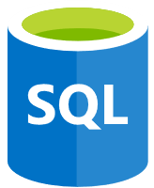


Prioritize your response to security issues with Secure Score
Gain instant insight into the security state of your cloud workloads
Address security vulnerabilities with prioritized recommendations
Improve your Secure Score and overall security posture in minutes
Evaluated Categories
Access
Compute
SQL server
Network
App
Secure Score Impact
+50
+40
+5
+8
+11
679
of 1.5K
Secure Score
@Techielass

Slide 35
Manage
Update Documentation
Update procedures
Staff training
@Techielass

Slide 36
Best practices by phase
Best Practice
Assess
“Redesign” every app for Azure!
Migrate
Select more powerful sizes of Azure resources during the migration and scale down (saves time during migrations)
Optimize
Watch out for migration leftovers like onetime backups sitting in Blob Storage or VHDs and Snapshots that aren’t being used
Secure & Manage
Migration isn’t complete until it is fully operatized without monitoring, backup, failover and security configured
@Techielass

Slide 37
Microsoft Cloud Adoption Framework for Azure
Best practices
Templates
People
Process
Technology
Documentation
Tools
Achieve balance
https://aka.ms/caf
@Techielass

Slide 38
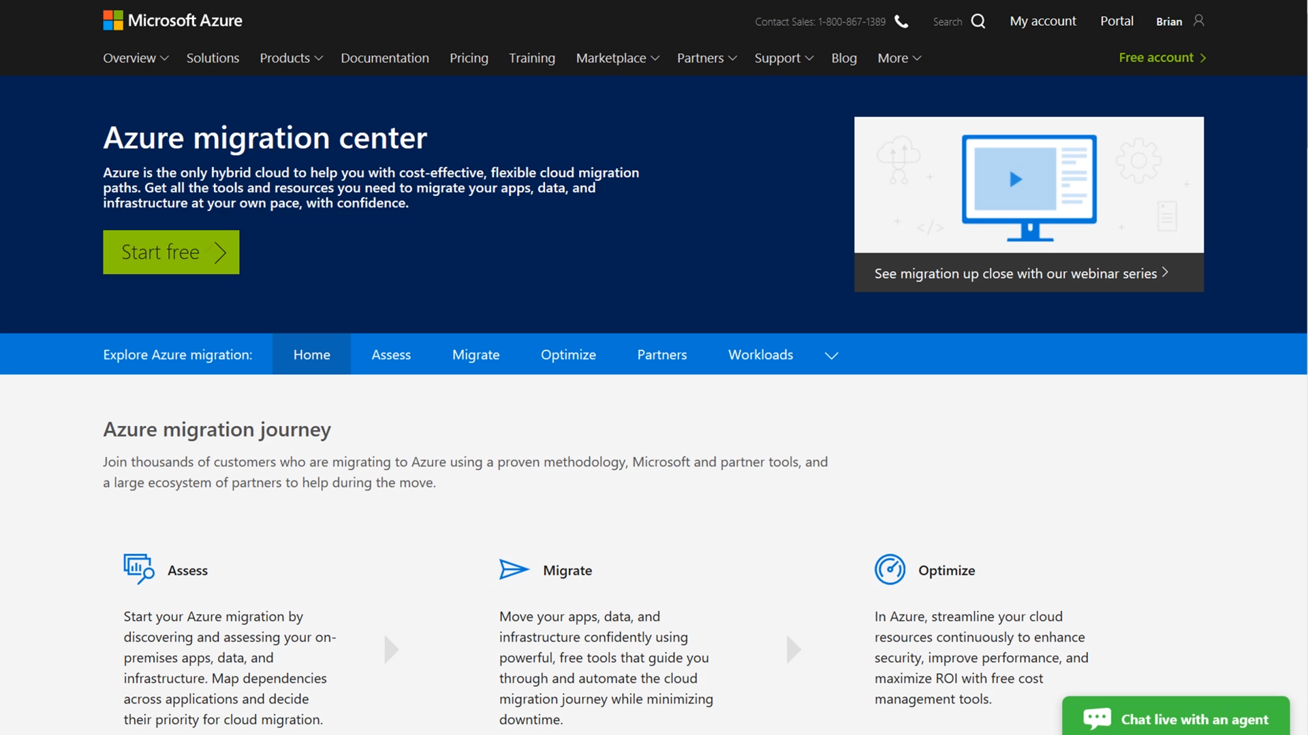
Azure migration center
Guidance
Tools
Partners
Migration journey and strategies
Right tools for the job
Migration experts
Azure.com/Migration
@Techielass

Slide 39

Thank you!
Sarah Lean
Cloud Advocate
@Techielass | www.techielass.com

